Slide 1
Chapter 17: Transactions
Notes:
事务是数据库管理系统进行并发控制和恢复的基本单位。讲解事务的基本概念、事务的ACID性质、事务并发执行的好处和潜在问题，以及并发事务的可串行性和可恢复性

Slide 2
Outline
Transaction Concept
A Simple Transaction Model
Concurrent Executions
Serializability
Recoverability
Transaction Isolation Levels
Transaction Definition in SQL

Slide 3
Transaction Concept
A transaction is a unit of program execution that accesses and possibly updates various data items.
E.g. transaction to transfer $50 from account A to account B:
In SQL:
    update account set balance=balance-50
    where account_number=A;
    update account set balance=balance+50
    where account_number=B;
    commit;
Two main issues to deal with:
  Failures of various kinds, such as hardware failures and system crashes
  Concurrent execution of multiple transactions

Slide 4
ACID Properties
Atomicity（原子性）. Either all operations of the transaction are properly reflected in the database or none are.
Consistency（一致性）. Execution of a transaction in isolation preserves the consistency of the database.
Isolation（隔离性）. Although multiple transactions may execute concurrently, each transaction must be unaware of other concurrently executing transactions. Intermediate transaction results must be hidden from other concurrently executed transactions.
  That is, for every pair of transactions T_{i} and T_{j}, it appears to T_{i} that either T_{j}, finished execution before T_{i} started, or T_{j} started execution after T_{i} finished.
Durability（持久性）. After a transaction completes successfully, the changes it has made to the database persist, even if there are system failures.

Slide 5
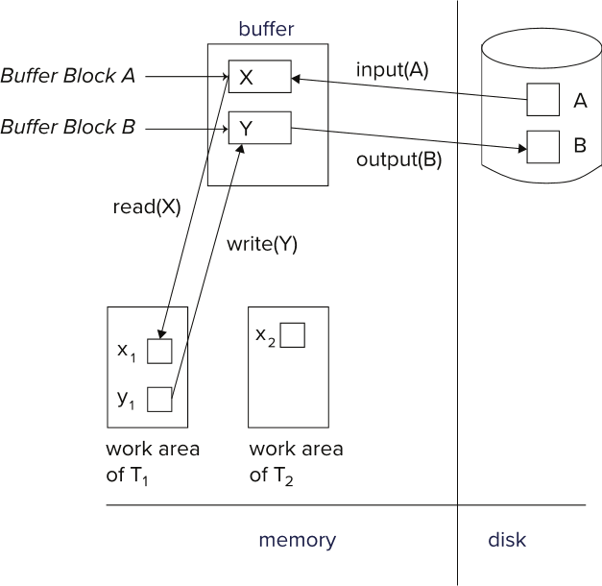
A Simple Transaction Model
Transactions access data using two operations:
  read(X), which transfers the data item X from the database to a variable, also called X， in a work area in main memory belonging to the transaction that executed the read operation.
  write(X), which transfers the value in the variable X in the main memory work area of the transaction that executed the write operation to the datat item X in database.

Slide 6
Example of Fund Transfer
Transaction to transfer $50 from account A to account B:
  1. read(A)
  2. A := A – 50
  3. write(A)
  -----------------------
  4. read(B)
  5. B := B + 50
  6. write(B)
Atomicity requirement
  if the transaction fails after step 3 and before step 6, money will be “lost” leading to an inconsistent database state
    Failure could be due to software or hardware
  the system should ensure that updates of a partially executed transaction are not reflected in the database
Durability requirement — once the user has been notified that the transaction has completed (i.e., the transfer of the $50 has taken place), the updates to the database by the transaction must persist even if there are software or hardware failures.
50
A：100
B：100
A - 50
B + 50

Slide 7
Example of Fund Transfer (Cont.)
Transaction to transfer $50 from account A to account B:
  1. read(A)
  2. A := A – 50
  3. write(A)
  ------------------------
  4. read(B)
  5. B := B + 50
  6. write(B)
Consistency requirement in above example:
  the sum of A and B is unchanged by the execution of the transaction
In general, consistency requirements include
    Explicitly（显式） specified integrity constraints :
      primary keys , foreign keys
    Implicit （隐式） integrity constraints, e.g. :
      sum of balances of all accounts minus sum of loan amounts must equal value of cash-in-hand
  A transaction must see a consistent database.
  During transaction execution the database may be temporarily inconsistent.
  When the transaction completes successfully the database must be consistent. Erroneous transaction logic can lead to inconsistency
50
A：100
B：100
A - 50
B + 50

Slide 8
Example of Fund Transfer (Cont.)
Isolation requirement — if between steps 3 and 6, another transaction T2 is allowed to access the partially updated database, it will see an inconsistent database (the sum A + B will be less than it should be).
T1 T2
  1. read(A)
  2. A := A – 50
  write(A)
  --------------------------- read(A), read(B), print(A+B)
  4. read(B)
  5. B := B + 50
  write(B )
Isolation can be ensured trivially by running transactions serially（串行）
  that is, one after the other.
However, executing multiple transactions concurrently has significant benefits, as we will see later.

Slide 9

Transaction State
A transaction must be in one of the following states:
  Active – the initial state; the transaction stays in this state while it is executing
  Partially committed – after the final statement has been executed.
  Failed -- after the discovery that normal execution can no longer proceed.
  Aborted – after the transaction has been rolled back and the database restored to its state prior to the start of the transaction. Two options after it has been aborted:
    restart the transaction
    kill the transaction
  Committed – after successful completion.
None or All

Slide 10
Concurrent Executions
Multiple transactions are allowed to run concurrently in the system. Advantages are:
  increased processor and disk utilization, leading to better transaction throughput
    E.g. one transaction can be using the CPU while another is reading from or writing to the disk
  reduced average response time for transactions: short transactions need not wait behind long ones.

Slide 11
Concurrent Executions
Anomalies in Concurrent Executions
  Lost Update（丢失修改）
  Dirty Read（读脏数据）
  Unrepeatable Read （不可重复读）
  Phantom Problem（幽灵问题 ）

Slide 12
Anomalies in Concurrent Executions-
Lost Update(丢失修改)
T1 | T2
Read A (100)
 | Read A (100)
A = A-1 (99)
 | A=A-1 (99)
Write A (99)
 | Write A (99)

Slide 13
Anomalies in Concurrent Executions-
Dirty Read（读脏数据）
T1 | T2
Read A (100)
A = A-1 (99)
Write A (99)
 | Read A (99)
 | A=A-1 (98)
rollback
 | Write A (98)
 | commit

Slide 14
Anomalies in Concurrent Executions-
Unrepeatable Read
T1 | T2
Read A (100)
 | Read A (100)
 | A=A-1 (99)
 | Write A (99)
Read A (99)

Slide 15
Anomalies with Concurrent Executions-
Phantom Problem
T1 | T2
select * from student where age=18 (100 records with age=18)
 | insert into student(id, gender, age) values(‘008’,’M’, 18) (Add a new record with age=18)
select * from student where age=18 (101 records with age=18 !!!)

Slide 16
Schedules
Schedule – a sequences of instructions that specify the chronological order in which instructions of concurrent transactions are executed
  a schedule for a set of transactions must consist of all instructions of those transactions
  must preserve the order in which the instructions appear in each individual transaction.
A transaction that successfully completes its execution will have a commit instructions as the last statement
  by default transaction assumed to execute commit instruction as its last step
A transaction that fails to successfully complete its execution will have an abort instruction as the last statement

Slide 17

Schedule 1
Let T₁ transfer $50 from A to B, and T₂ transfer 10% of the balance from A to B.
A serial schedule in which T₁ is followed by T₂ :

Slide 18

Schedule 2
A serial schedule where T₂ is followed by T₁

Slide 19
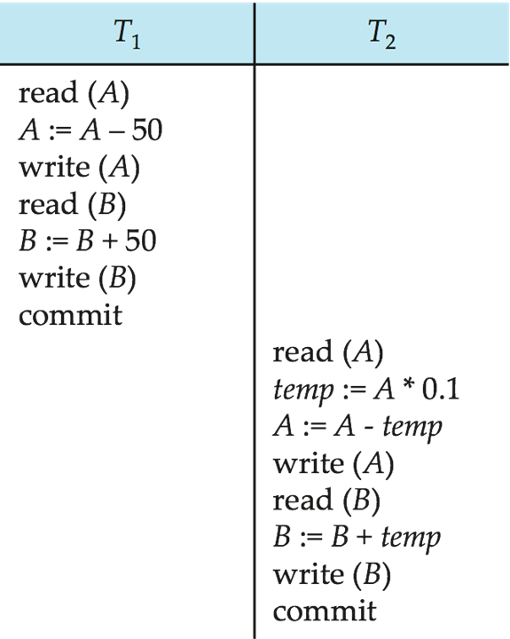

Schedule 3
Let T₁ and T₂ be the transactions defined previously. The following schedule is not a serial schedule, but it is equivalent to Schedule 1.
100
50
50
50
5
45
100
150
150
150
155
In Schedules 1, 2 and 3, the sum A + B is preserved.

Slide 20

Schedule 4
The following concurrent schedule does not preserve the value of (A + B ).
100
50
100
10
90
100
50
100
150
110

Slide 21
Serializability(可串行化 )
Basic Assumption – Each transaction preserves database consistency.
Thus serial execution of a set of transactions preserves database consistency.
A (possibly concurrent) schedule is serializable if it is equivalent to a serial schedule.
Different forms of schedule equivalence give rise to the notions of:
  conflict serializability(冲突可串行化 )
  view serializability（视图可串行化）

Slide 22
Conflicting Instructions
Instructions l_{i} and l_{j} of transactions T_{i} and T_{j} respectively, conflict if and only if there exists some item Q accessed by both l_{i} and l_{j}, and at least one of these instructions wrote Q.
1. l_{i} = read(Q), l_{j} = read(Q). l_{i} and l_{j} don’t conflict.
2. l_{i} = read(Q), l_{j} = write(Q). They conflict.
3. l_{i} = write(Q), l_{j} = read(Q). They conflict
4. l_{i} = write(Q), l_{j} = write(Q). They conflict
Intuitively, a conflict between l_{i} and l_{j} forces a (logical) temporal order between them.
  If l_{i} and l_{j} are consecutive in a schedule and they do not conflict, their results would remain the same even if they had been interchanged in the schedule.

Slide 23
Conflict Serializability（冲突可串行化）
If a schedule S can be transformed into a schedule S´ by a series of swaps of non-conflicting instructions, we say that S and S´ are conflict equivalent.
We say that a schedule S is conflict serializable if it is conflict equivalent to a serial schedule

Slide 24


Conflict Serializability (Cont.)
Schedule 3 can be transformed into Schedule 6, a serial schedule where T₂ follows T₁, by series of swaps of non-conflicting instructions. Therefore Schedule 3 is conflict serializable.
Schedule 3
Schedule 6

Slide 25

Conflict Serializability (Cont.)
Example of a schedule that is not conflict serializable:
We are unable to swap instructions in the above schedule to obtain either the serial schedule < T₃, T₄ >, or the serial schedule < T₄, T₃ >.

Slide 26

Testing for Serializability
Consider some schedule of a set of transactions T₁, T₂, ..., T_{n}
Precedence graph（前驱图 ） — a directed graph where the vertices are the transactions (names).
We draw an arc from T_{i} to T_{j} if the two transaction conflict, and T_{i} accessed the data item on which the conflict arose earlier.
We may label the arc by the item that was accessed.
Example 1

Slide 27

Test for Conflict Serializability
A schedule is conflict serializable if and only if its precedence graph is acyclic.
Cycle-detection algorithms exist which take order n² time, where n is the number of vertices in the graph.
  (Better algorithms take order n + e where e is the number of edges.)
If precedence graph is acyclic, the serializability order can be obtained by a topological sorting of the graph.
  This is a linear order consistent with the partial order of the graph.

Slide 28
Example Schedule (Schedule A) + Precedence Graph
T₁ T₂ T₃ T₄ T₅
read(X)
read(Y)
read(Z)
read(V)
read(W)
read(W)
read(Y)
write(Y)
write(Z)
read(U)
read(Y)
write(Y)
read(Z)
write(Z)
read(U)
write(U)
T₁
T₂
前驱图
T₄
T₃
T₅
T1 T2 T3 T4
拓扑图
T1 T3 T2 T4
T₅

Slide 29
Different forms of Serializability
Different forms of schedule equivalence give rise to different forms of serializability.
  conflict serializability
  (冲突可串行化 )
    same order of the conflict operation pairs
  view serializability
  （视图可串行化）
    same data content of the corresponding read （Q） operations
    same data content （Q） of the final write （Q） operations
T1 read the initial value of A . T1 read the initial value of B.
T2 read the value of A that was produced by T1. T2 read the value of B that was produced by T1.
T2 performs the final write(A). T2 performs the final write(B).
Schedule 1
Schedule 3

Slide 30
View Serializability（视图可串行化）
Let S and S´ be two schedules with the same set of transactions. S and S´ are view equivalent if the following three conditions are met, for each data item Q,
  If in schedule S, transaction T_{i} reads the initial value of Q, then in schedule S’ also transaction T_{i} must read the initial value of Q.
  If in schedule S transaction T_{i} executes read(Q), and that value was produced by transaction T_{j} (if any), then in schedule S’ also transaction T_{i} must read the value of Q that was produced by the same write(Q) operation of transaction T_{j} .
  The transaction (if any) that performs the final write(Q) operation in schedule S must also perform the final write(Q) operation in schedule S’.

Slide 31

View Serializability (Cont.)
A schedule S is view serializable if it is view equivalent to a serial schedule.
Every conflict serializable schedule is also view serializable.
Below is a schedule which is view-serializable but not conflict serializable.
What serial schedule is above equivalent to?
  T27 – T28 – T29

Slide 32
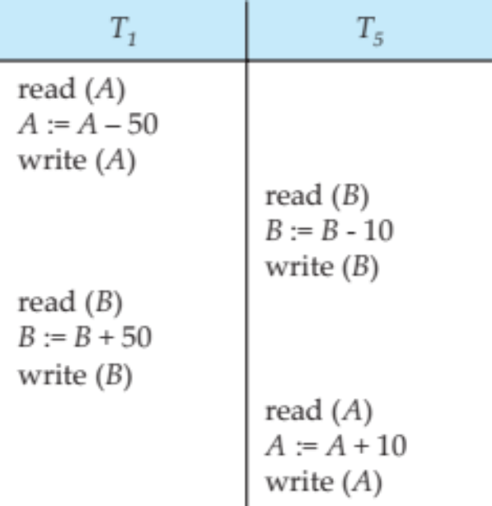
Other Notions of Serializability
The schedule below produces same outcome as the serial schedule < T₁, T₅ >, yet is not conflict equivalent or view equivalent to it.
Determining such equivalence requires analysis of operations other than read and write.
(B-10)+50 = (B+50)-10
In our example, the final result is the same as that of the serial schedule <T1,T5>， because of the mathematical fact that the increment and decrement operations are commutative.
The general case is not so easy since a transaction may be expressed as a complex SQL statement, a Java program with JDBC calls, etc.

Slide 33

Recoverable Schedules
Recoverable schedule（可恢复调度） — if a transaction T_{j} reads a data item previously written by a transaction T_{i} , then the commit operation of T_{i} appears before the commit operation of T_{j}.
The following schedule (Schedule 11) is not recoverable if T₉ commits immediately after the read
If T₈ should abort, T₉ would have read (and possibly shown to the user) an inconsistent database state. Hence, database must ensure that schedules are recoverable.

Slide 34

Cascading Rollbacks
Cascading rollback – a single transaction failure leads to a series of transaction rollbacks. Consider the following schedule where none of the transactions has yet committed (so the schedule is recoverable)
If T₁₀ fails, T₁₁ and T₁₂ must also be rolled back.
Can lead to the undoing of a significant amount of work

Slide 35
Cascadeless Schedules
Cascadeless schedules（无级联调度） — cascading rollbacks cannot occur; for each pair of transactions T_{i} and T_{j} such that T_{j} reads a data item previously written by T_{i}, the commit operation of T_{i} appears before the read operation of T_{j}.
Every cascadeless schedule is also recoverable
It is desirable to restrict the schedules to those that are cascadeless

Slide 36
Concurrency Control & Serializability
A database must provide a mechanism that will ensure that all possible schedules are
  either conflict or view serializable, and
  are recoverable and preferably cascadeless
Testing a schedule for serializability after it has executed is a little too late!
Goal – to develop concurrency control protocols that will assure serializability.
Concurrency-control protocols allow concurrent schedules, but ensure that the schedules are conflict/view serializable, and are recoverable and cascadeless .
Concurrency control protocols generally do not examine the precedence graph as it is being created
  Instead a protocol imposes a discipline that avoids nonseralizable schedules.
Different concurrency control protocols provide different tradeoffs between the amount of concurrency they allow and the amount of overhead that they incur.
Tests for serializability help us understand why a concurrency control protocol is correct.

Slide 37
Weak Levels of Consistency
Some applications are willing to live with weak levels of consistency, allowing schedules that are not serializable
  E.g. a read-only transaction that wants to get an approximate total balance of all accounts
  E.g. database statistics computed for query optimization can be approximate
  Such transactions need not be serializable with respect to other transactions
Tradeoff accuracy for performance

Slide 38
Transaction Isolation Levels
Serializable — default
Repeatable read — only committed records to be read, repeated reads of same record must return same value. However, a transaction may not be serializable – it may find some records inserted by a transaction but not find others.
Read committed — only committed records can be read, but successive reads of record may return different (but committed) values.
Read uncommitted — even uncommitted records may be read.
Lower degrees of consistency useful for gathering approximate
information about the database
Warning: some database systems do not ensure serializable schedules by default
  E.g. Oracle and PostgreSQL by default support a level of consistency called snapshot isolation (not part of the SQL standard)

Slide 39
Transaction Definition in SQL
In SQL, a transaction begins implicitly.
A transaction in SQL ends by:
  Commit work commits current transaction and begins a new one.
  Rollback work causes current transaction to abort.
In almost all database systems, by default, every SQL statement also commits implicitly if it executes successfully
  Implicit commit can be turned off by a database directive
    E.g., in JDBC -- connection.setAutoCommit(false);
Isolation level can be set at database level
Isolation level can be changed at start of transaction
    E.g. In SQL set transaction isolation level serializable
    E.g. in JDBC -- connection.setTransactionIsolation(
    Connection.TRANSACTION_SERIALIZABLE)

Slide 40

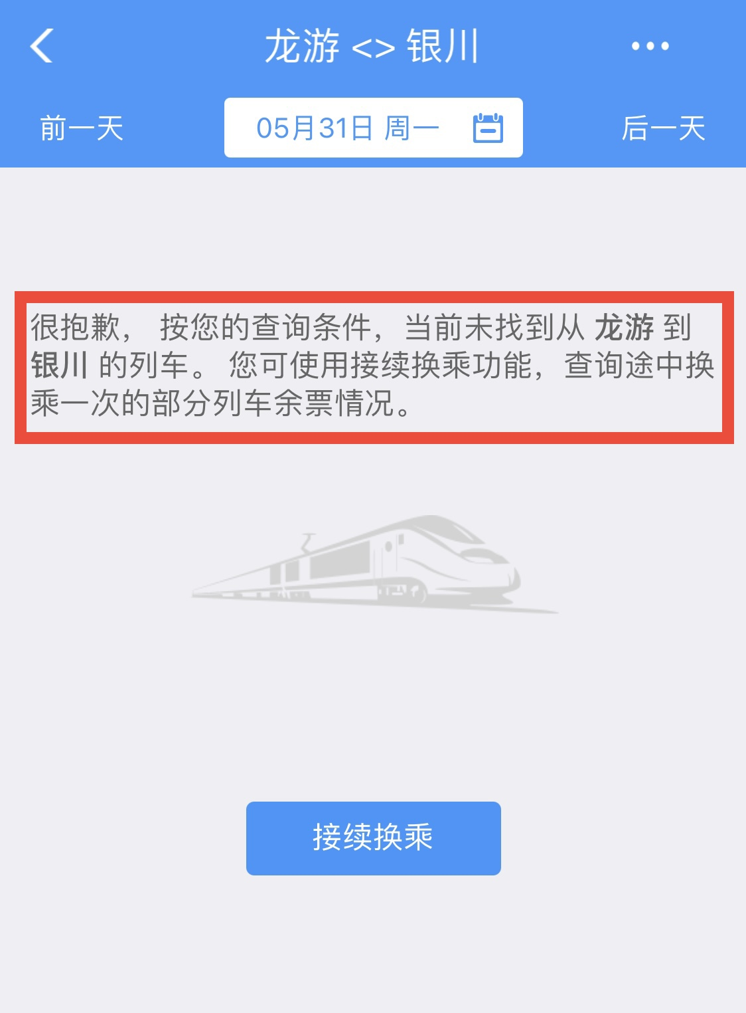
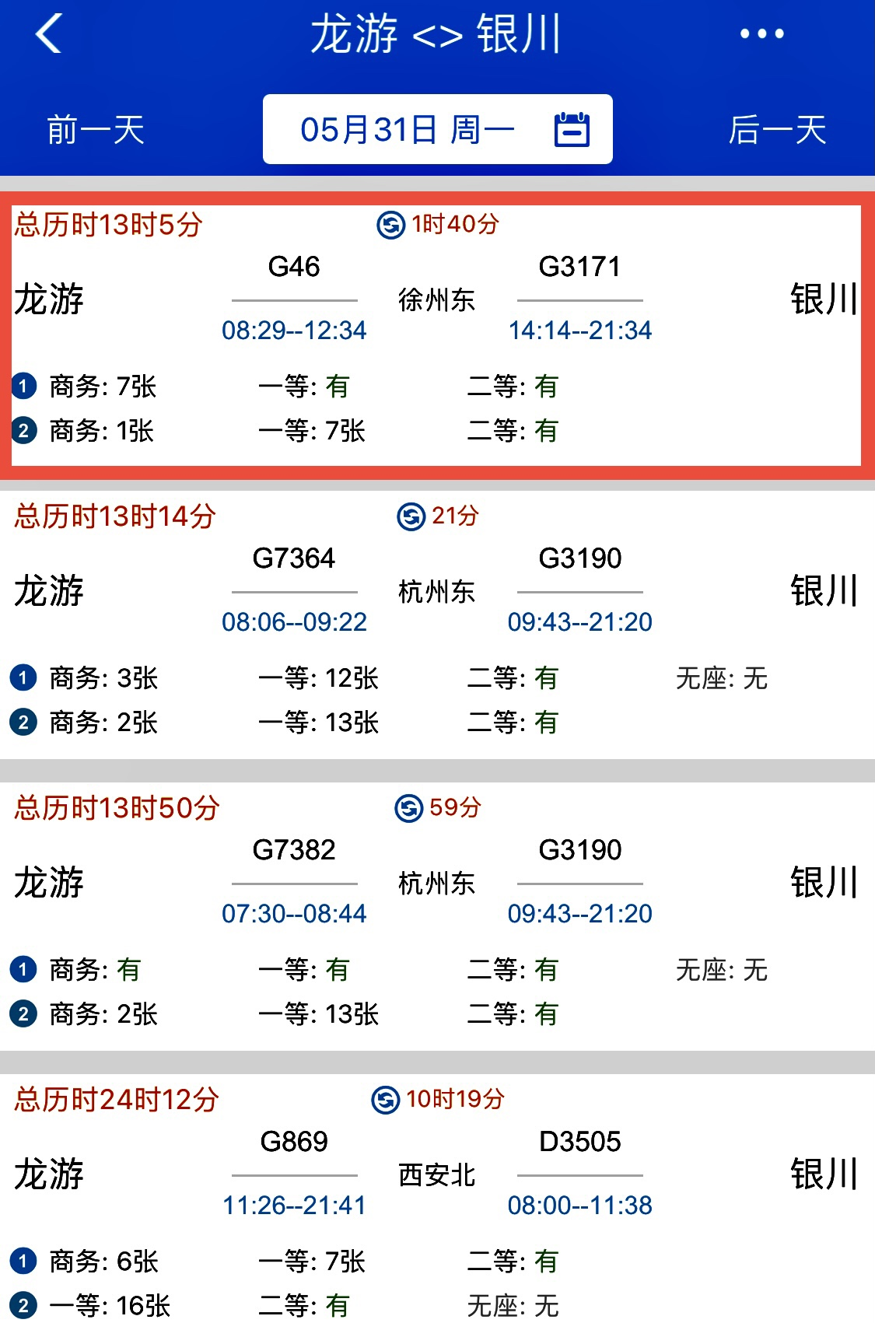
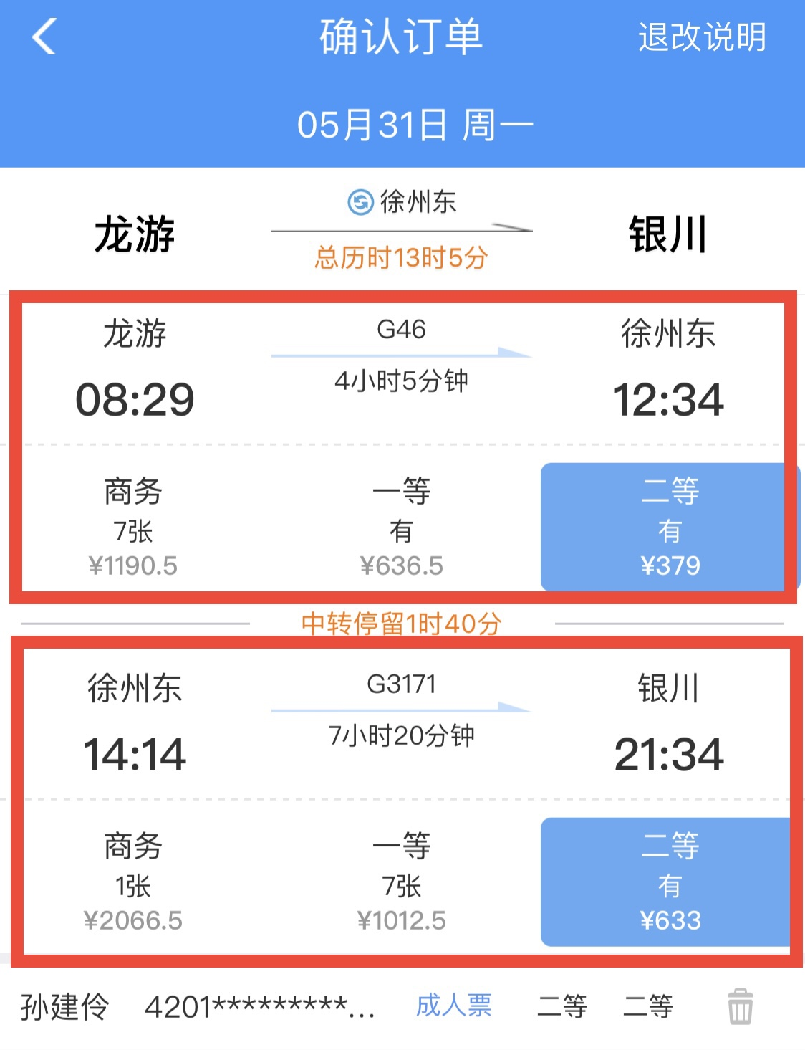
Transaction Examples
Transaction Boundaries
  Booking one ticket vs multiple tickets?

Slide 41
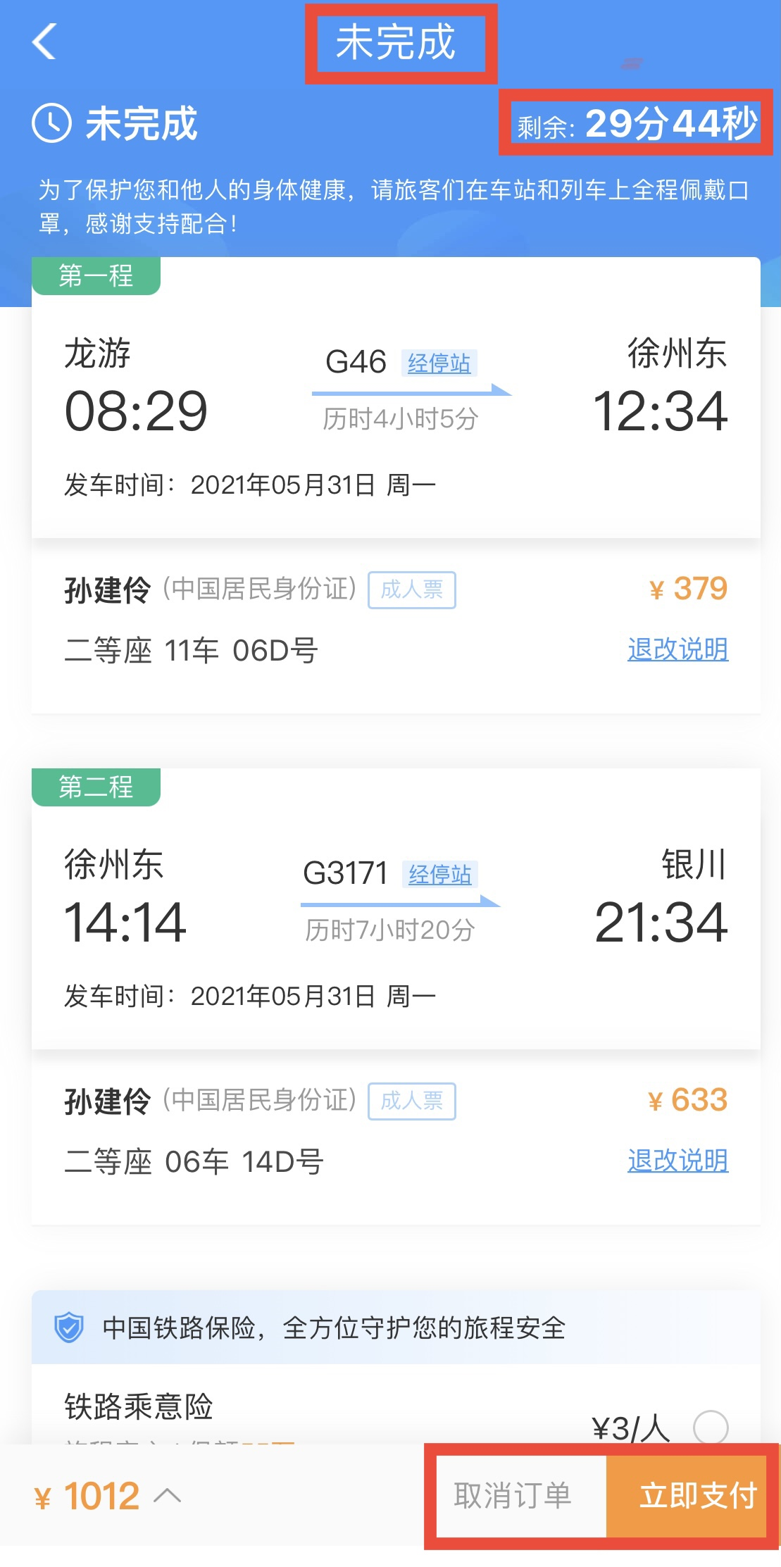
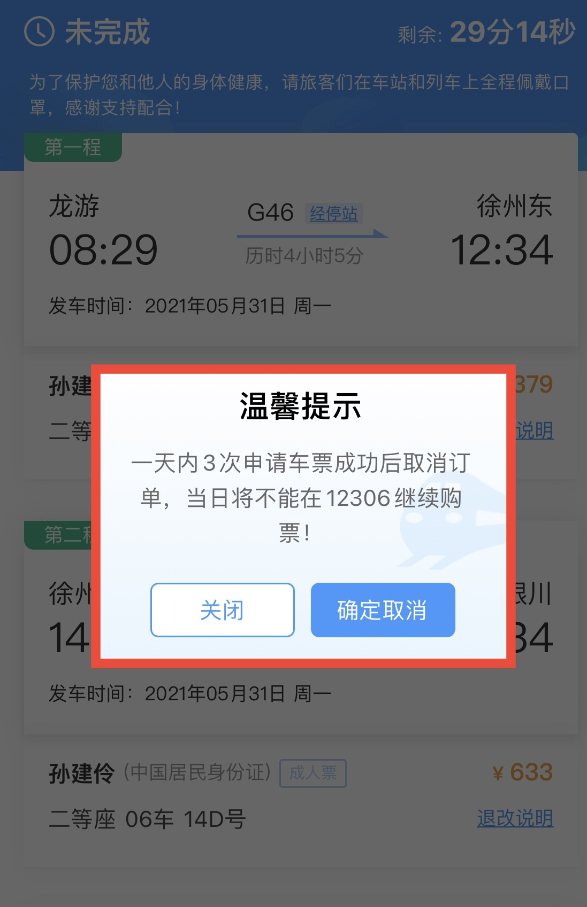
Transaction Examples
Transaction Boundaries
  Booking tickets & paying order - combining vs separating ?

Slide 42
Concurrency Control Protocols
Lock-Based Protocols
  Lock on whole database vs lock on items
  How long to hold lock?
  Shared vs exclusive locks
Timestamp-Based Protocols
  Transaction timestamp assigned e.g. when a transaction begins
  Data items store two timestamps
    Read timestamp
    Write timestamp
  Timestamps are used to detect out of order accesses
Validation-Based Protocols
  Optimistic concurrency control
  Low rate of conflicts among transactions
  Each transaction must go through 3 phases:
    Read phase → Validation phase → Write phase

